Slide 1
ABAP程式分析優化技轉
Wistron SAP Enhancement Project
IBM
2024/09

Slide 2
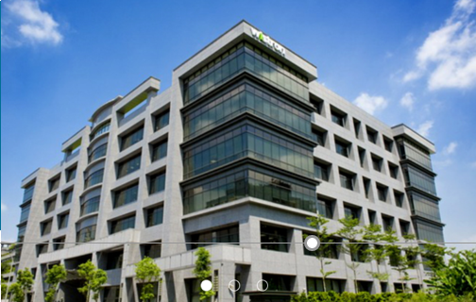

Agenda
1
SAP Fundamental
2
SAP System Monitoring
3
程式效能分析分類方法

Slide 3
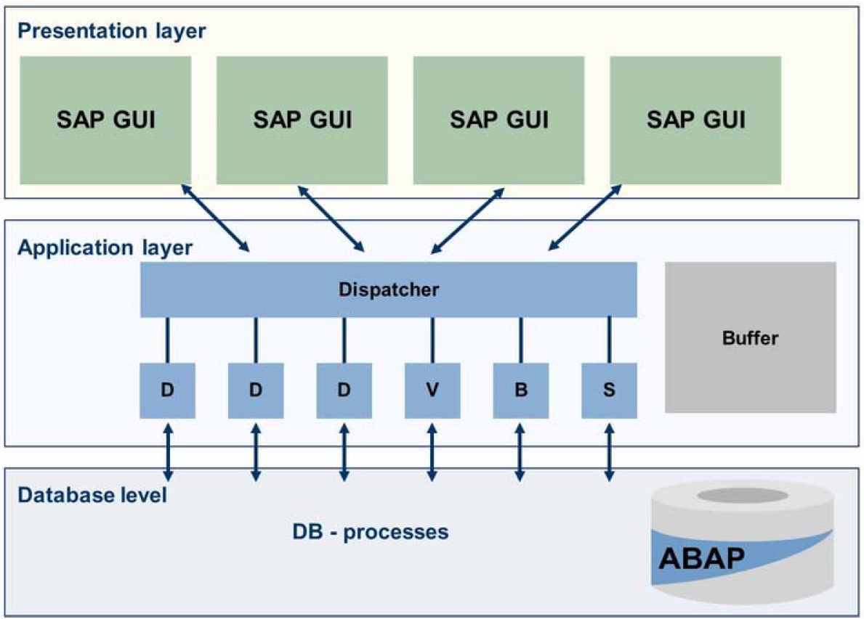
Processing a User Request

Slide 4
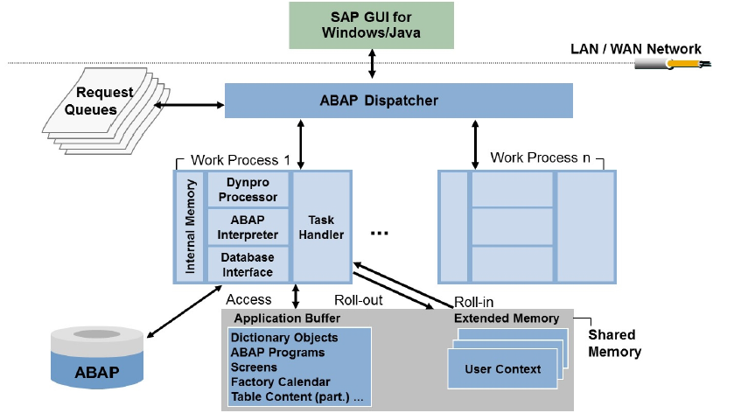
Process Flow for Request

Slide 5
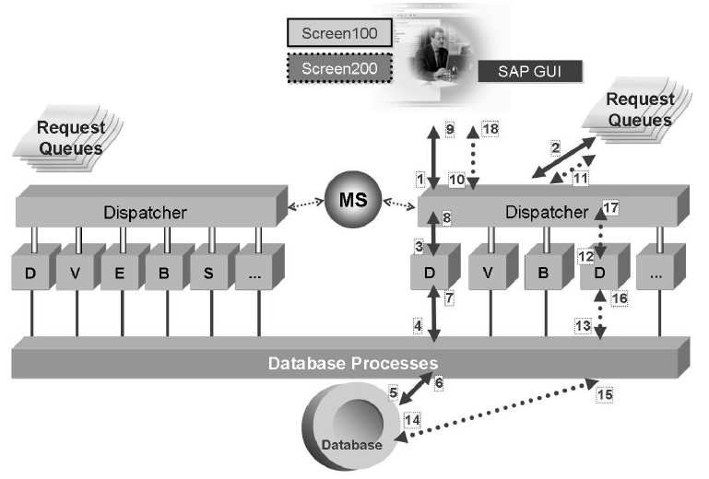
Process Multiplexing

Slide 6
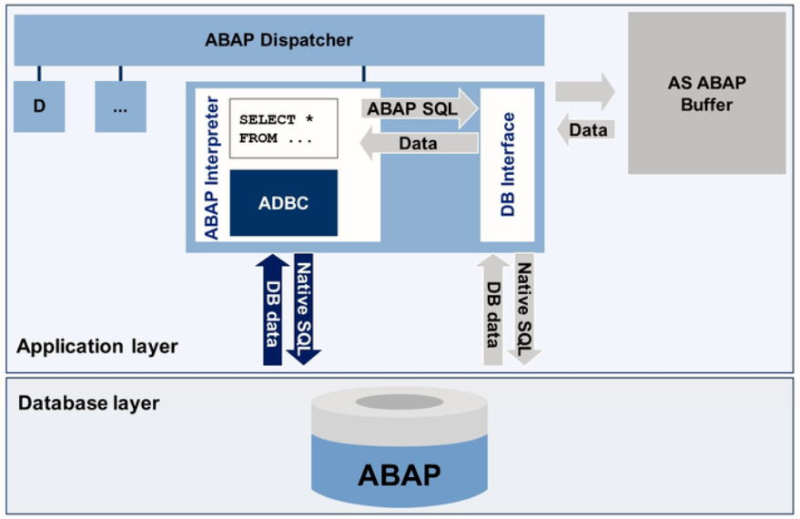
Database Query Flow

Slide 7
Native SQL Advantages and Disadvantages – EXEC SQL statement
Advantages
Tables are not declared in ABAP Dictionary can be accessed. (e.g. Tables belonging to sys or system user of Oracle, etc.)
To use some of the special features supported by the database-specific SQL. (e.g. Passing hints to Oracle optimizer.)
Disadvantages
No syntax check is performed whatever is written between EXEC and ENDEXEC.
ABAP program containing database-specific SQL statements will not run under different database systems.
There is no automatic client handling for client dependent tables.
Care has to be taken during migration to higher versions.

Slide 8
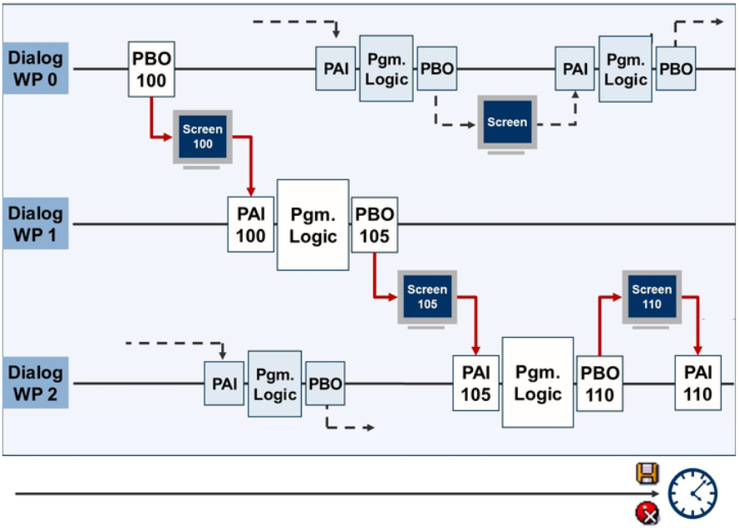
Dialog Work Process Multiplexing

Slide 9
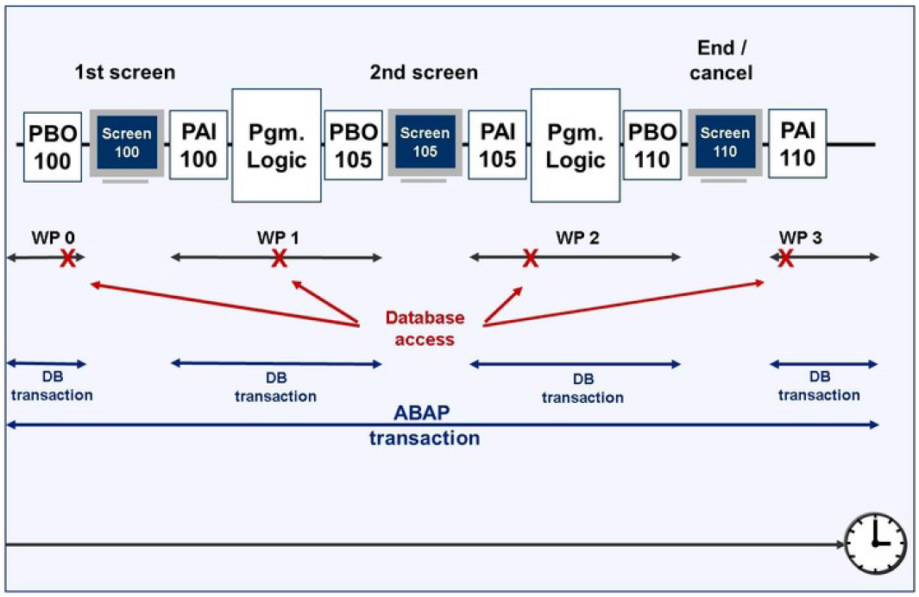
Relationship between database transactions and SAP transactions

Slide 10
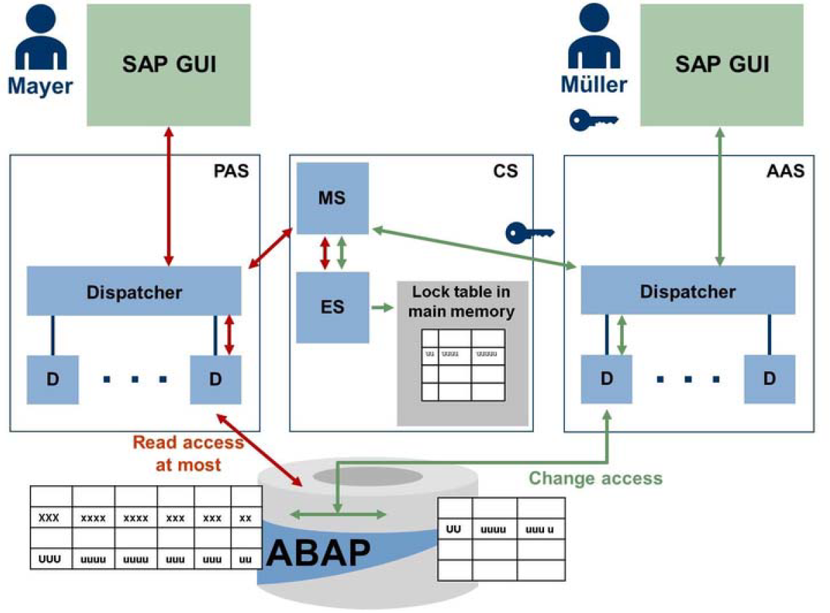
Lock Management in AS ABAP

Slide 11
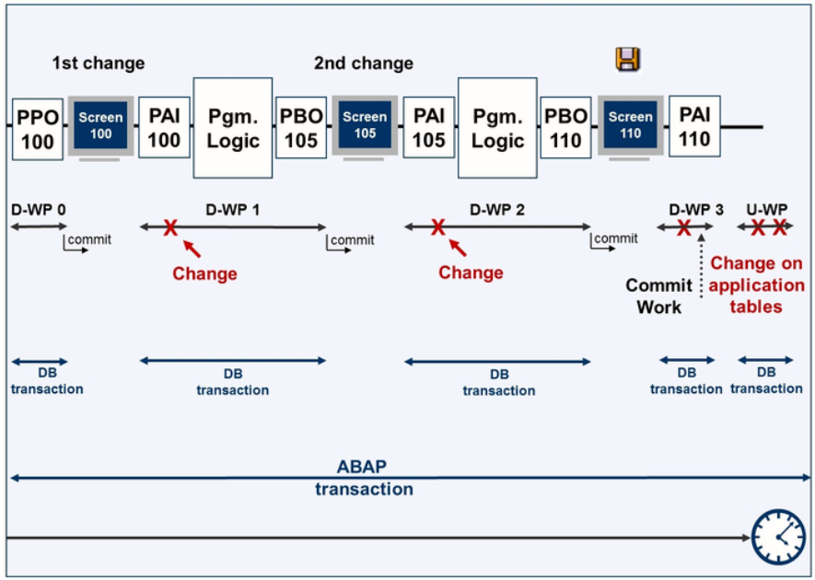
The Principle of Asynchronous Updates

Slide 12
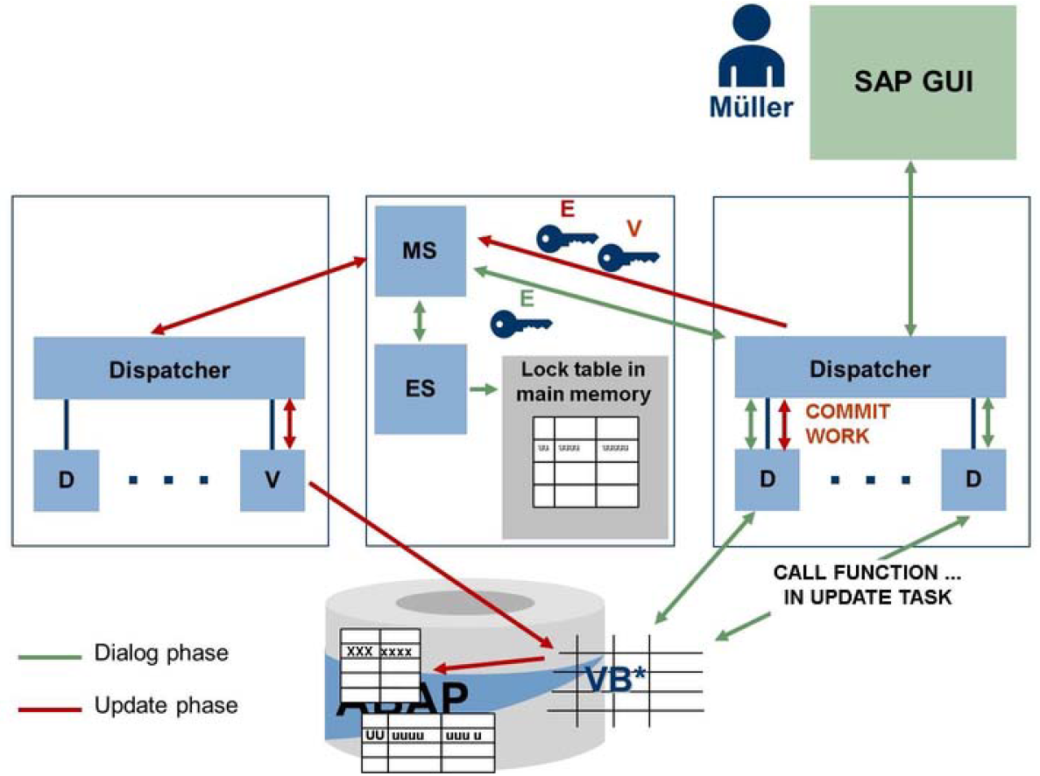
The Asynchronous Update Process

Slide 13
Agenda
1
SAP Fundamental
2
SAP System Monitoring
3
程式效能分析分類方法

Slide 14
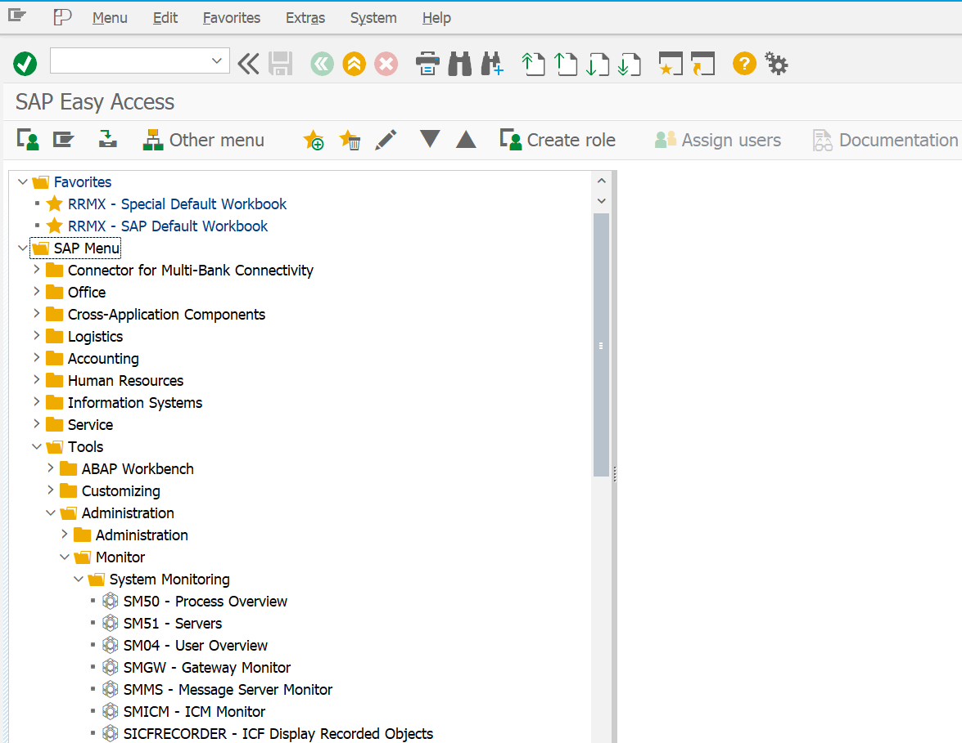
Monitor SAP System
Monitor System :
Process Overview – SM50
Servers – SM51
User Overview – SM04
List of All Users Logged on – AL08

Slide 15
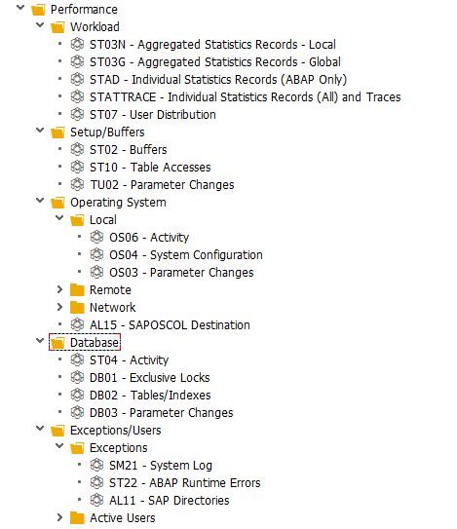
SAP System Performance
Performance
Workload
Analysis
Application Monitor
Setup / Buffer
Buffers
Table Accesses
Parameter Changes
Operating System
Database
Exceptions / Users

Slide 16
Monitor Process Overview (SM50)
Process status :
Running
The process is executing a system request.
Waiting
The process is idle and waiting for any system request.
Hold
The process is held by a single user.
Completed
The process has been aborted with the restart option set to No.
Shutdown The work process was terminated because the application server instance was shut down.

Slide 17
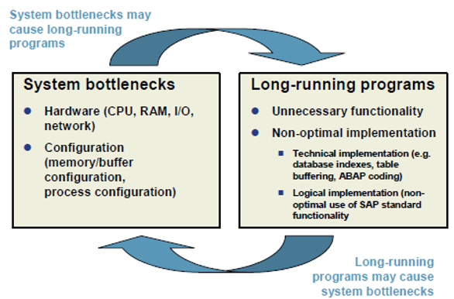
SAP System Performance

Slide 18
SAP System Performance
What is Workload Analysis?
Goal: Optimizing system performance
Maximize system-wide throughput
Minimize program response time

Slide 19
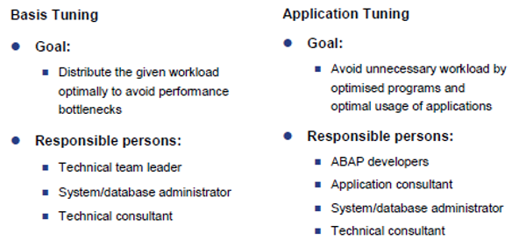
Performance Tuning

Slide 20
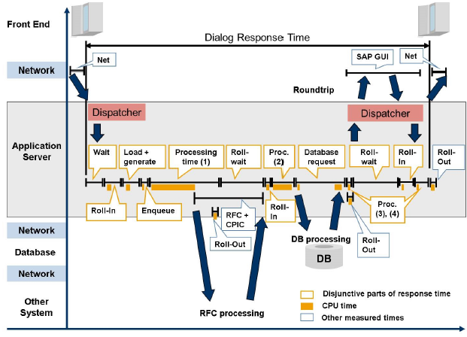
Time Definition
Definition :
Response Time: Time taken by the user request from dispatcher to GUI
Wait Time: Work processes request is waiting in dispatcher Queue
Roll-in time: User context data moves from the roll area to work process
Roll-out time: process of user context data from the work process to Roll area
Roll -wait Time: Time b/w roll in and roll out
Load Time: Time of Loading the program from the database to buffer
DB request Time: Time of retrieving/insert the report from/to the data base
CPU time: Time of executing report logic in CPU
Processing Time: Report or program executing time

Slide 21
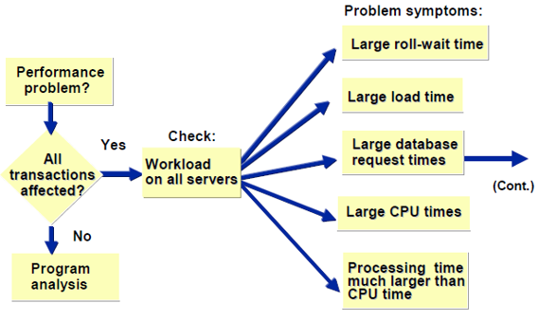
Performance Analysis Roadmap

Slide 22
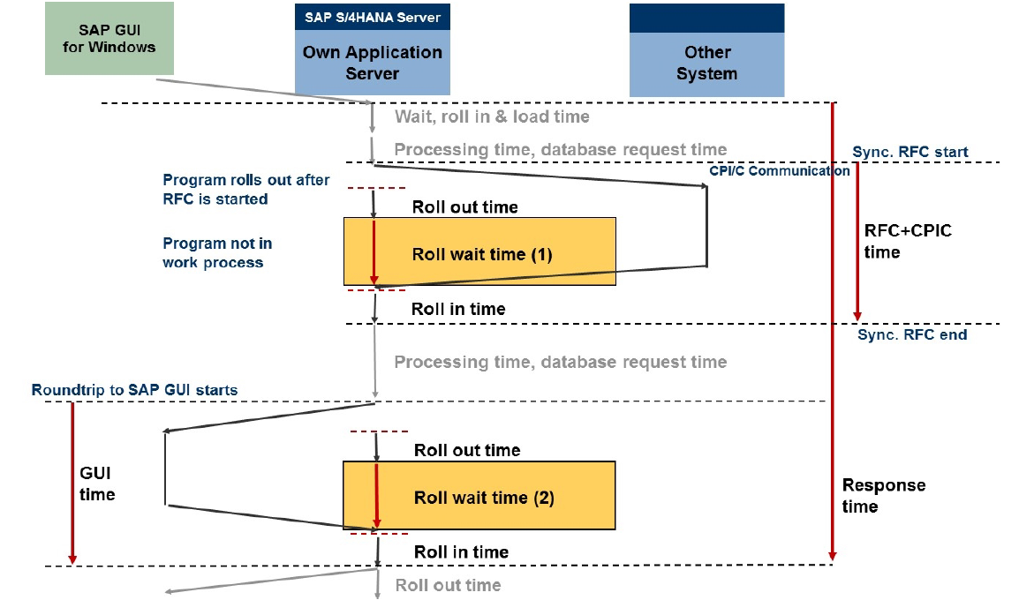
Roll Wait Time due to Synchronous RFC and Roundtrips to the Front End

Slide 23
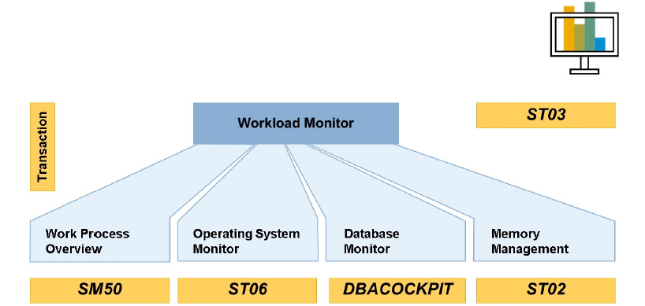
Performance Monitors in Basis

Slide 24
Workload Monitor [ST03(N)]

Slide 25
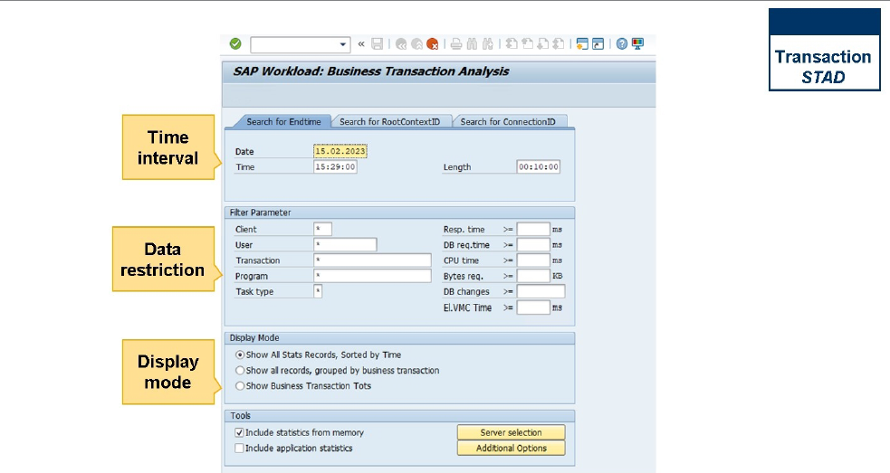
SAP Workload - STAD

Slide 26
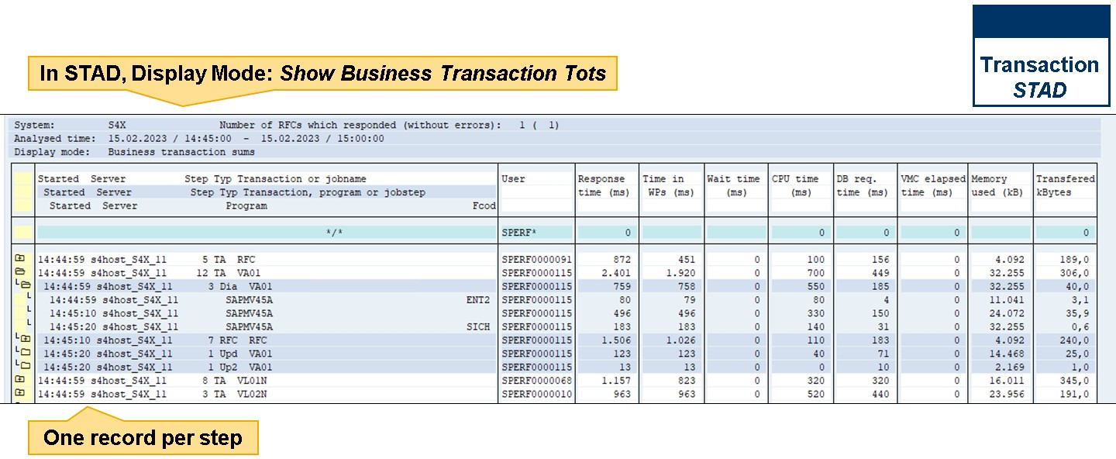
SAP Workload - STAD

Slide 27
SAP Workload - STAD

Slide 28
Guideline Values for Analyzing Average Response Time for Task Type Dialog – 1
Time | Guideline Value | Problem Indicated
Dispatcher wait time (Wait time) | <10% of response time; <50 ms | General performance problem with many possible causes
Load time (Load + gen time) | <50 ms | Program buffer too small or CPU bottleneck
Roll-in time, Roll out time | <20 ms | SAP roll buffer or SAP extended memory too small or CPU bottleneck
Roll wait time | <200 ms | Problem with frontend communication (together with higher GUI time) or with communication with external component
GUI time | <200 ms | Problem with frontend communication ( together with higher roll wait time)

Slide 29
Guideline Values for Analyzing Average Response Time for Task Type Dialog - 2
Time | Guideline Value | Problem Indicated
Enqueue time | <5 ms | Problem with enqueue or network problems
Processing time CPU time | Processing time <2 x CPU time | CPU bottleneck or communication problem
Database time (DB request time) | <40% of response time minus dispatcher wait time; Guideline value 200-600 ms | Database problem, network problem, or CPU bottleneck
Time per DB request | <5 ms | Database Problem
Direct reads | <2 ms | Database Problem
Sequential reads | <10 ms | Database Problem
Changes and commits | <25 ms | Database Problem

Slide 30
System Programs in the Transaction Profile
Transaction / Program | Description / Comment | Acceptable Response Time
MainMenu | Actions in the menu. MainMenu frequently appears near the top of the list if sorted according to Dialog Steps. | <100 ms
AutoABAP | The AutoABAP runs periodically in the background and executes actions like those required by the Alert Monitor | <1000 ms
Buf.Sync | Display table buffer (buffer synchronization). | <1000 ms
(B)SCHDL | The batch scheduler runs periodically and check whether background programs are dure to be started
RSCOLL00 | The performance collector runs periodically and collects data on performnace. If you sort the transaction profile according to Response Time Total, this program is often near the top of the list. However, the CPU Time Total and DB Time Total columns indicate that this program produces little CPU or database time. Most of the response time for this program occurs when it is waiting in work processes for performance data.
RSM13000 | The update program is used to summarize all update module statistics that cannot be ascribed to a transaction. | <3000 ms

Slide 31
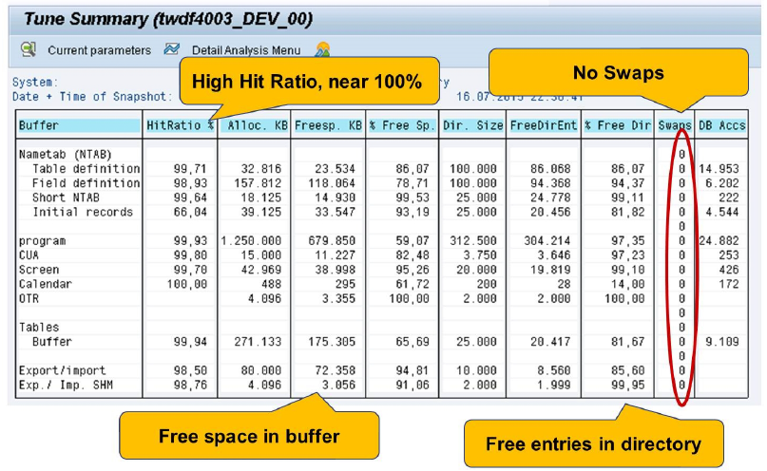
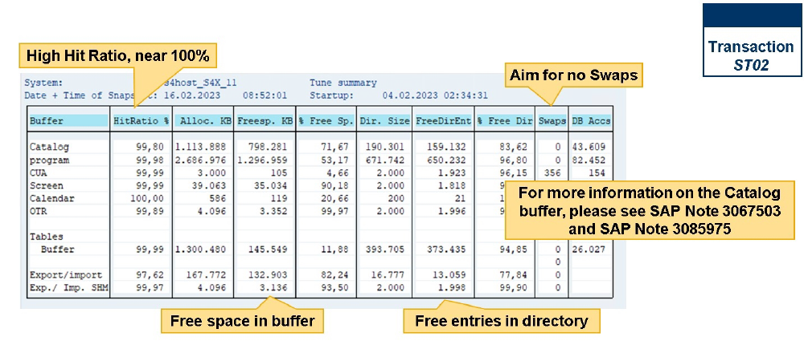
SAP Buffers [ST02]
Buffers: There are several buffers and they help to access data more rapidly, as well as to execute ABAP programs faster. An access to a buffer can be one hundred times faster than an access to the database.
Therefore, applying the rules with care can lead optimal performance.

Slide 32
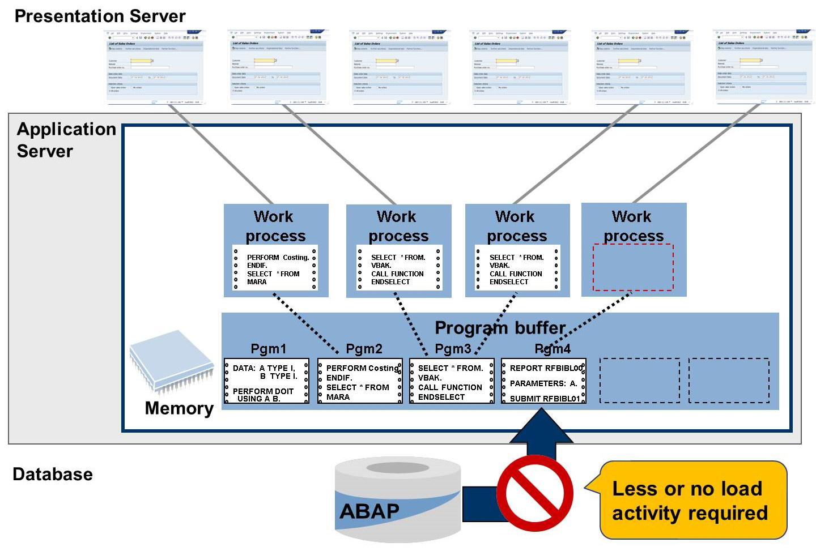
The Solution for the Problem

Slide 33
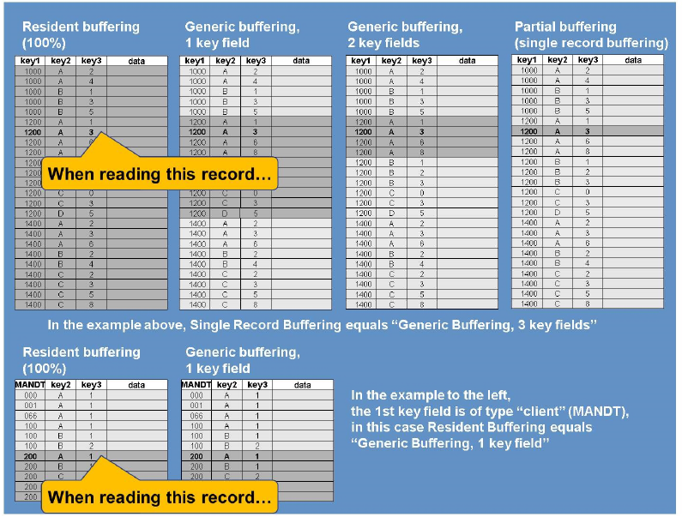
SAP Table Buffer Type
There are three types of table buffering:
Partial buffering or single-record buffering
Generic Key buffering (by key fields)
Full buffering or resident buffering

Slide 34
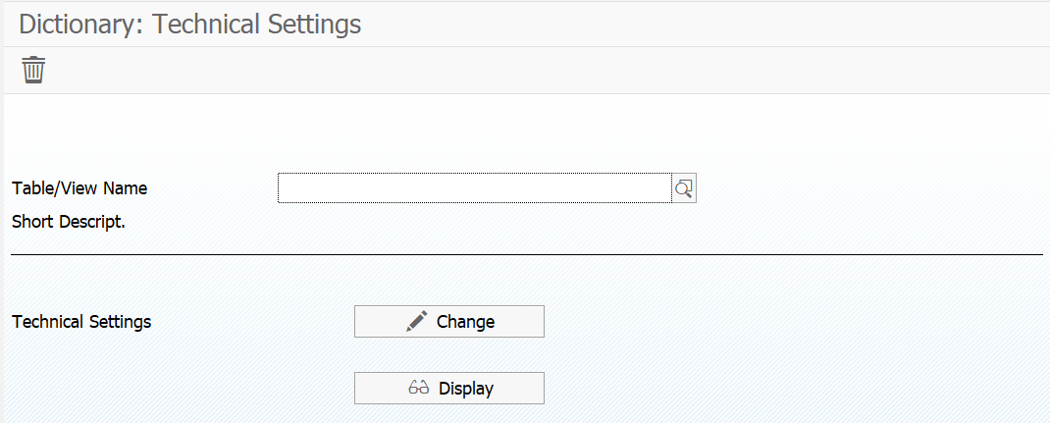
SAP Table Buffer Change (SE13)
Specify whether a table is allowed to be buffered or not
Specify the buffering type

Slide 35
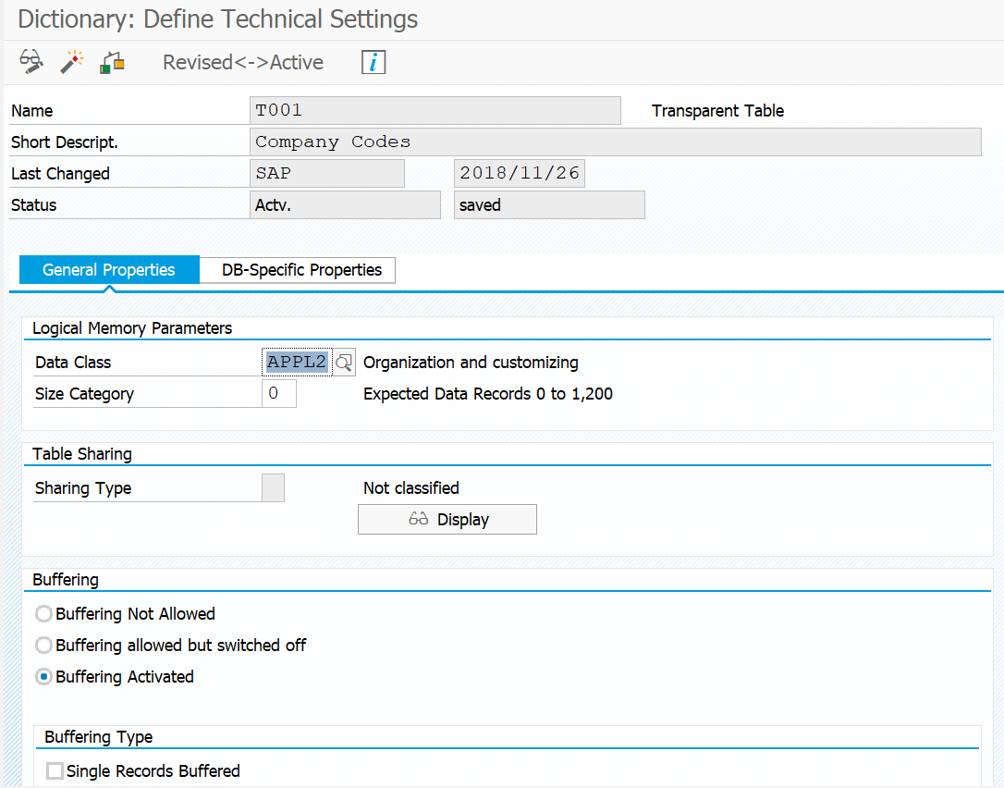
SAP Table Buffer Setting

Slide 36
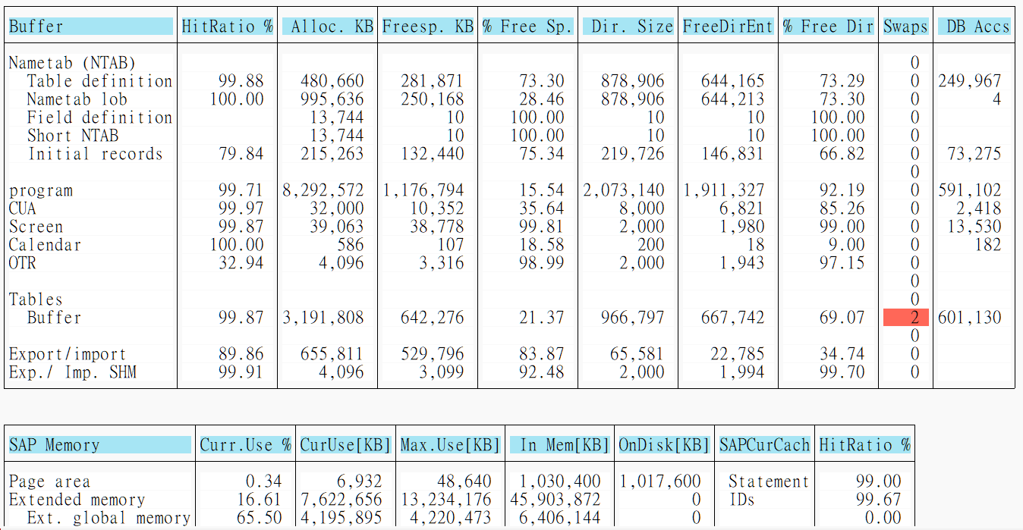
SAP Table Buffer Monitoring (ST02)

Slide 37
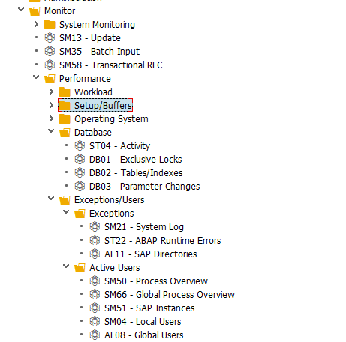
DB & Exceptions Monitoring

Slide 38
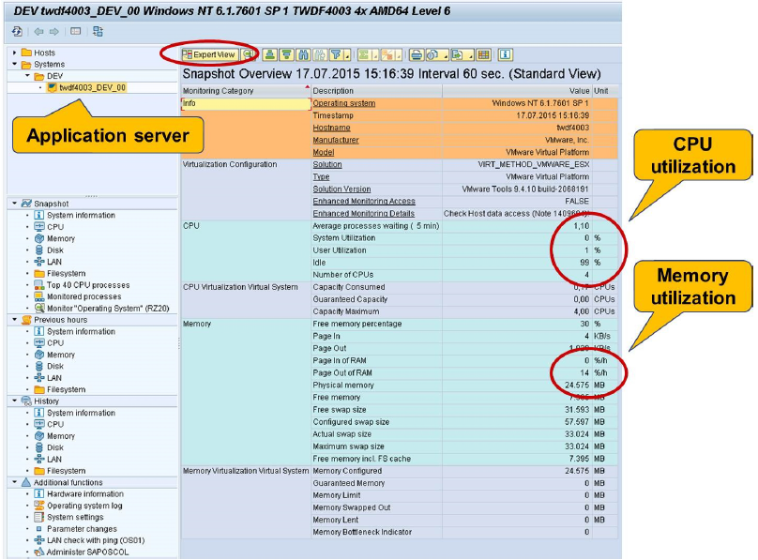
OS Performance (ST06)

Slide 39
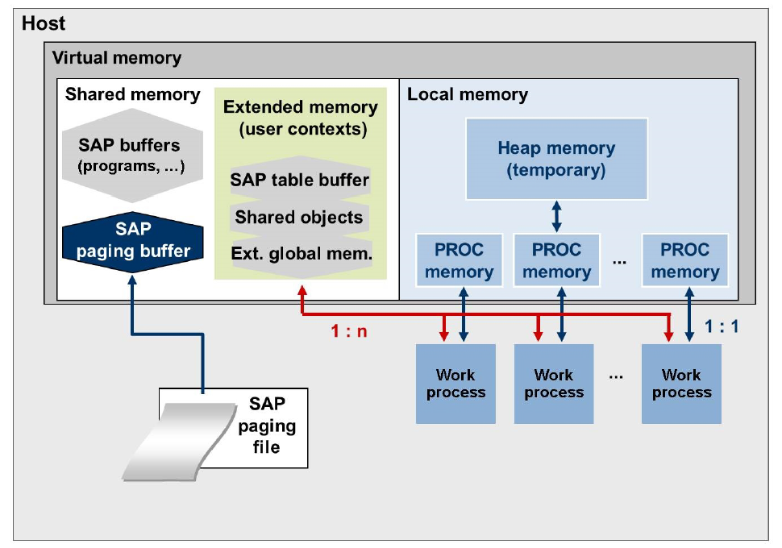
SAP Memory Areas: Overview

Slide 40
Order in Which Memory Is Allocated for SAP WP, and Sequence for Dialog and Nondialog WP
 | Dialog Work Process | Nondialog Work Process
1 | Local SAP roll memory up to ztta/roll_area | Local SAP roll memory up to ztta/roll_area
2 | SAP extended memory until ztta/roll_extension is reached or until SAP extended memory is used up | SAP heap memory until abap/heap_area_nondia is reached or until SAP heap memory is used up
3 | Local SAP roll memory up to ztta/roll_area | ─
4 | SAP heap memory until abap/heap_area_dia is reached or until SAP heap memory is used up | SAP extended memory until ztta/roll_extension is reached or until SAP extended memory is used up
5 | Program termination | Program termination

Slide 41
Memory Area and Contents of an SAP Instance
Memory Area | Implementation | Size (MB) | Contents
SAP roll memory | Shared memory (roll buffer), role file | N x 10 | User contexts: temporary transaction-based data assigned to a user session
SAP extended memory | Shared memory | N x 100 to N x 1000 | For example, screen lists, internal tables, variables, administrative data.
SAP heap memory | Local memory | N x 100 to N x 1000
SAP buffer | Shared memory | N x 100 | Global data that can be accessed by all users, for example, program codes, table and field definitions, and so on.
SAP EG memory | Shared memory (part of SAP extended memory) | N x 10 | Temporary data exchanged between user contexts
SAP Paging memory | Shared memory (paging buffer), SAP paging file | N x 100 | Temporary data exchanged between user contexts, data extracts
SAP work processes | Local memory | N x 10 per WP | Executable program, local data, local roll and local paging memory; SAP cursor cache and so on.
Compare: Database instance | Shared memory, local ,memory | N x 100 to N x 1000 | Database buffer and database processes

Slide 42
Memory Maximum Size
Refer SAP Notes 146289, 425207

Slide 43
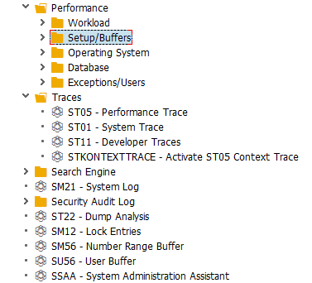
SAP Trace
There are many trace options in SAP systems.
System Log (SM21)
Dump Analysis (ST22)
System Trace (ST01)
Performance Trace (ST05)
Developer Traces (ST11)

Slide 44
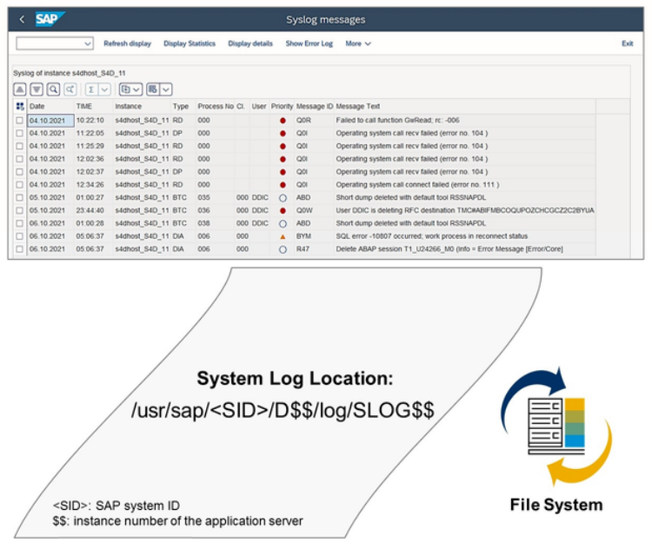
System Log (SM21)
System Log :
You can use the System Log to detect and correct errors in your system and its environment.
SAP application servers record events and problems in system logs.
Every SAP application server has a local log that contains the messages output by this server.
You can display the following types of log :
- Local SysLog
- Remote SysLog
- All rem. SysLogs
- Central SysLog

Slide 45
Dump Analysis (ST22)
Dump Analysis :
If unpredictable error occur during runtime when you call an ABAP program, a runtime error that generates a short dump can occur.
Different error situation exist :
- Internal Error
- Installation and Environment / Resource Error
- Error in Application Program
Long Text of the Runtime Error :
Most of the sections of the long text are informative and helpful for different people, depending on their technical knowledge.
The large number of sections can be divided into four large blocks:
- System Environment
- User View
- ABAP Developer View
- BASIS Developer View

Slide 46
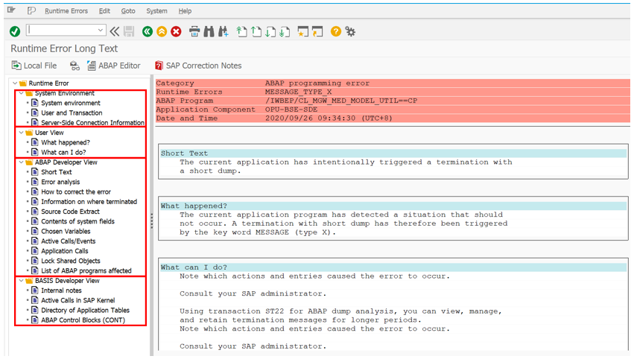
Runtime Error Long Text (ST22)

Slide 47
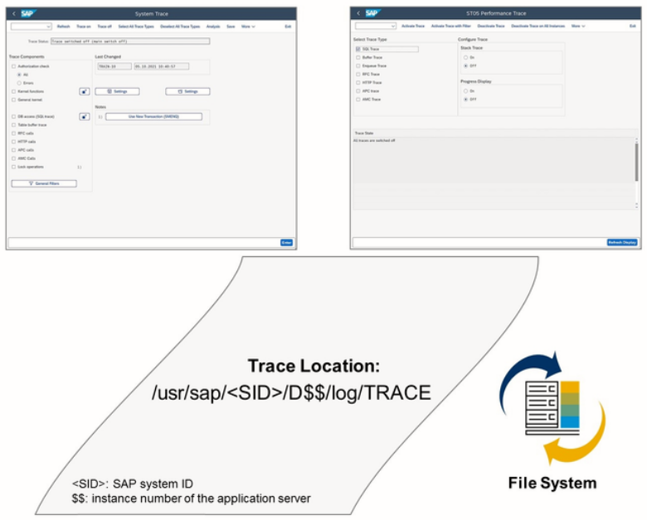
System Trace (ST01)
System Trace :
You can use the system trace to record internal system activities.
For system monitoring and problem analysis, SAP recommend that you use the system log or the developer trace.
The system trace is used for analyzing :
- Authorization checks
- Kernel functions and Kernel module
- DB accesses (SQL trace)
- Accesses to table buffers
- Lock operations
- RFC calls

Slide 48
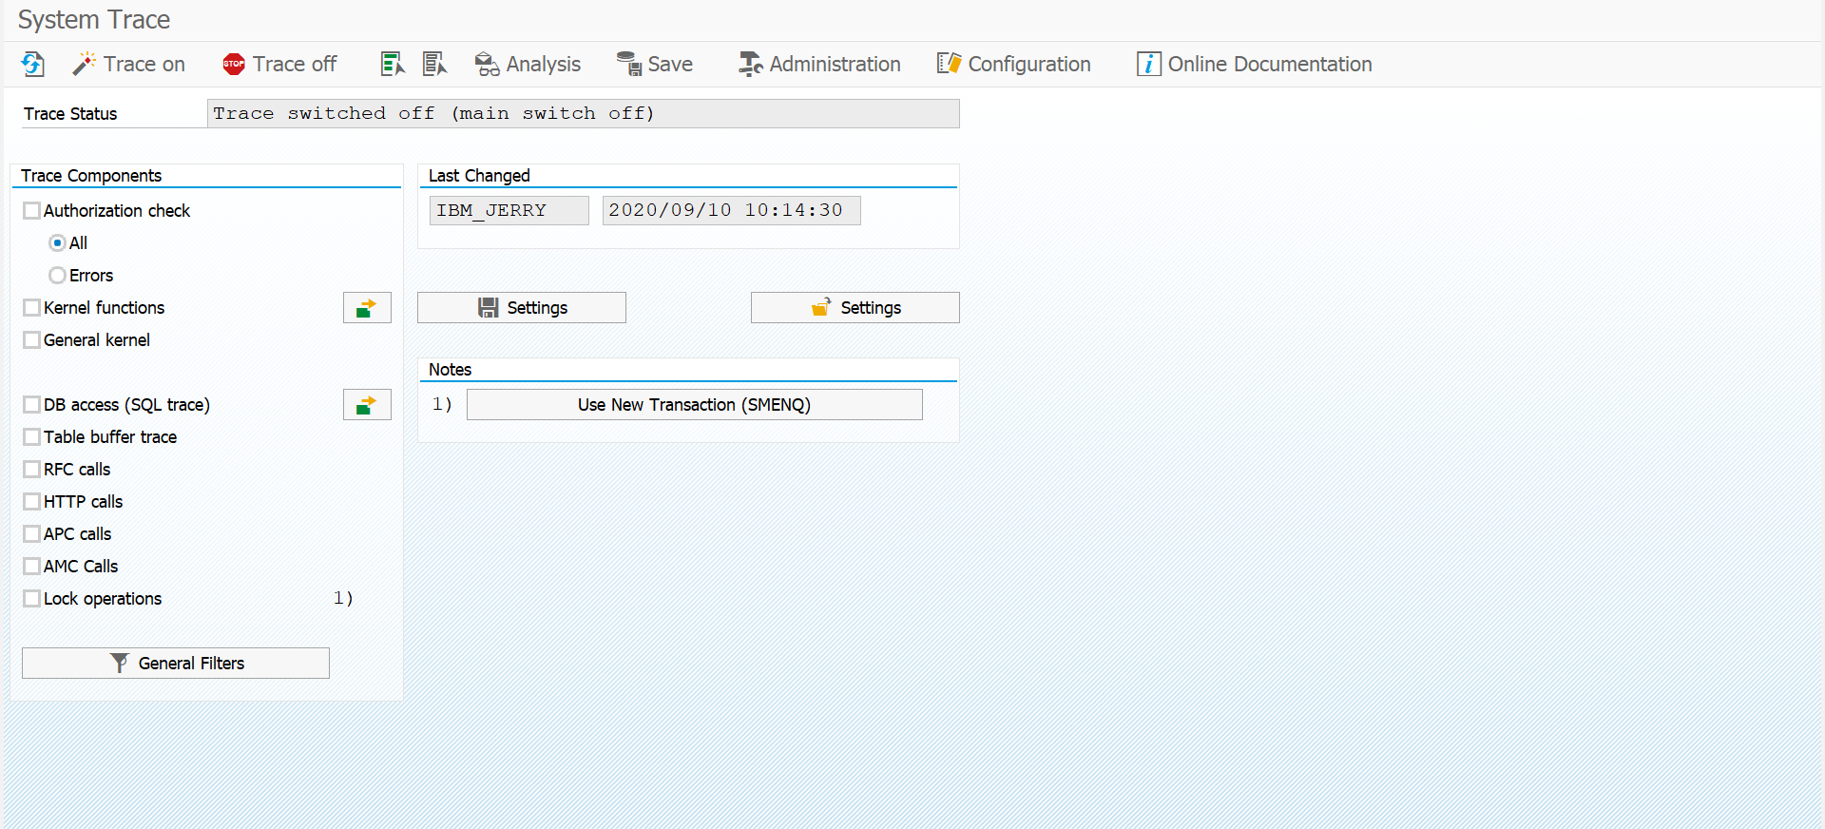
System Trace (ST01)
Component | Abbreviation | Object
Authorization check | AUTH | Authorization object used
Kernel functions | CMOD | Corresponding C function in kernel
General kernel | USER | Module in the kernel in which the trace is written
DB accesses | SQL | Database table being accessed (SQL trace)
Table buffer trace | BUFF | Database table being accessed
RFC calls | RFC | Called function module
Lock Operations | ENQUE | Lock object used

Slide 49
Performance Trace (ST05)
Performance Trace :
The performance trace provides similar trace options to the system trace.
It allow you to record :
- Database call (SQL Trace)
Lock management call (Enqueue Trace)
Accesses to table buffers (Buffer Trace)
Remote call s of reports and transactions (RFC Trace)
HTTP communication (HTTP Trace)
Single SQL statements (Enter SQL Statement)

Slide 50
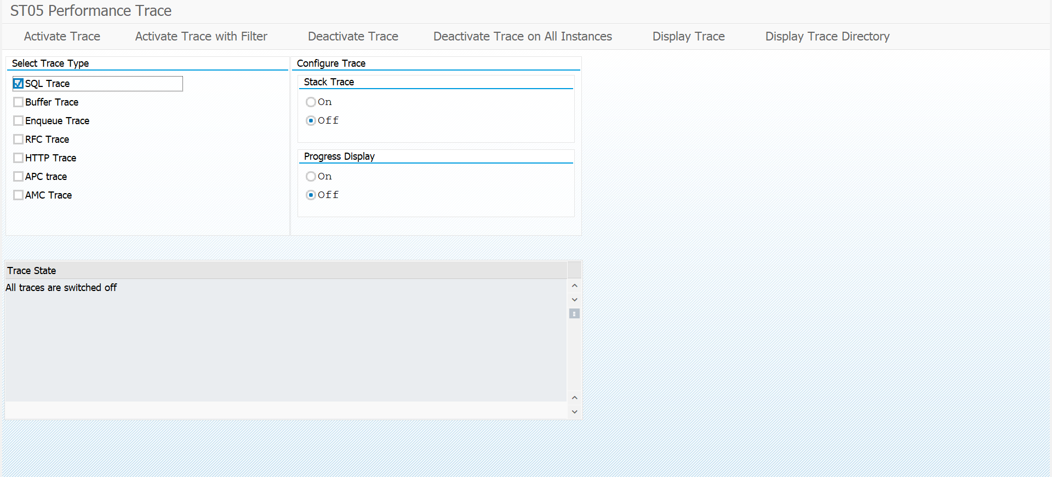
Performance Trace (ST05)

Slide 51
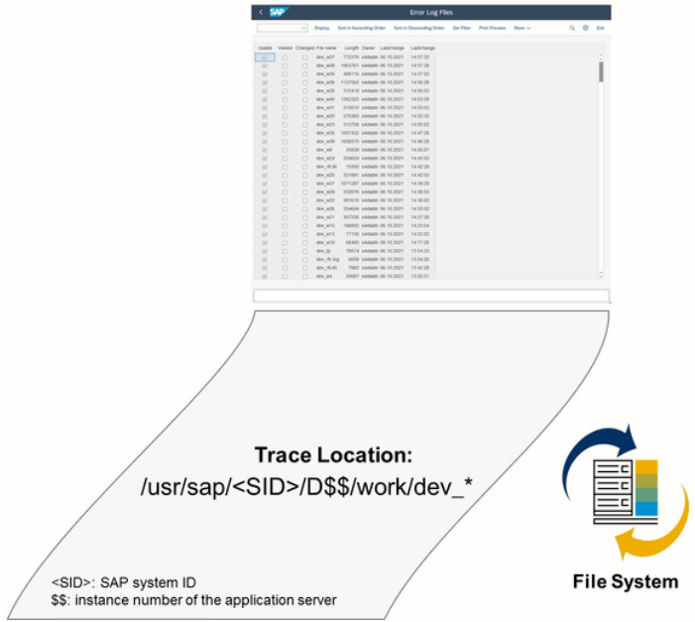
Developer Trace (ST11)
Developer Trace :
Developer traces are recordings that contain technical information and that are used if error occur.
This type of trace is especially useful to investigate host and internal SAP problems affecting your SAP system.
Activating / Deactivating Developer Traces:
- 0: No trace
- 1: Write error messages in the trace file
- 2: Full trace
- 3: Additionally, trace data blocks
You can use system profile parameters to
- Restrict the size of the trace files
- Specify an appropriate path

Slide 52
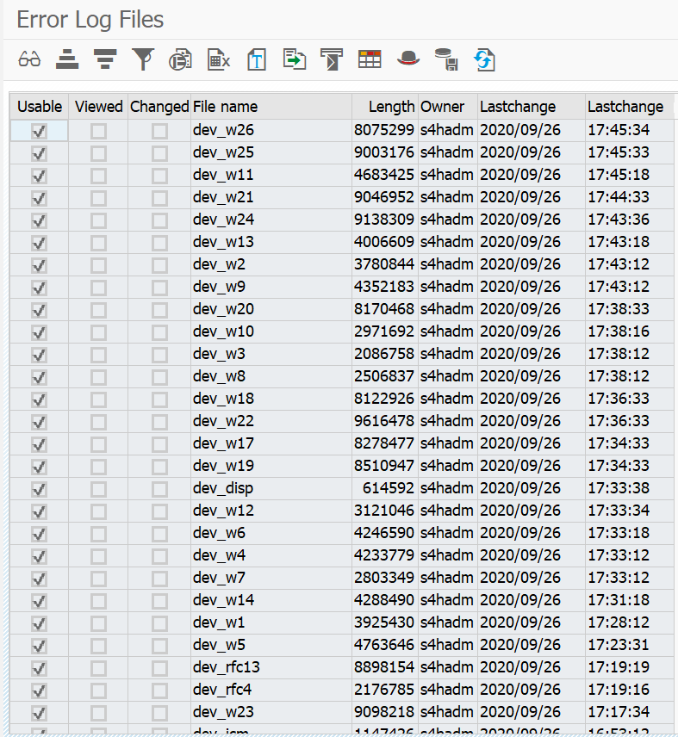
Error Log Files (ST11)

Slide 53
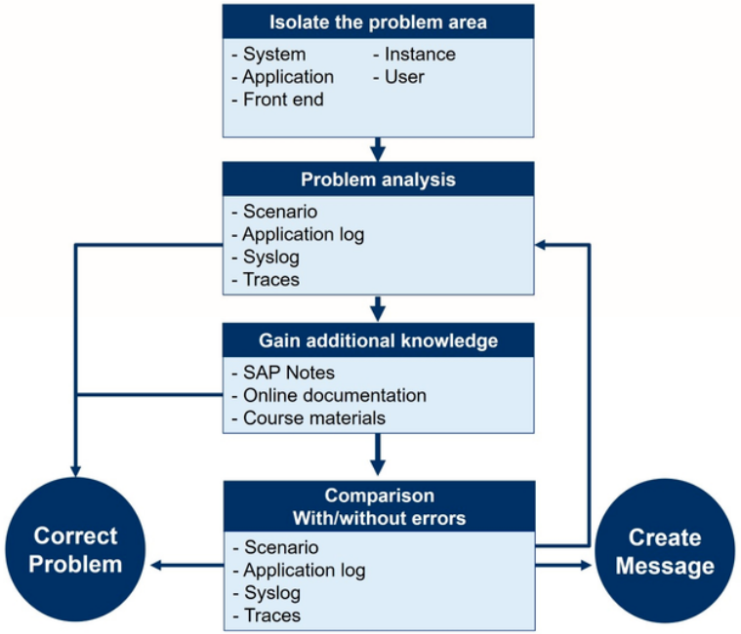
Troubleshooting: Approach

Slide 54
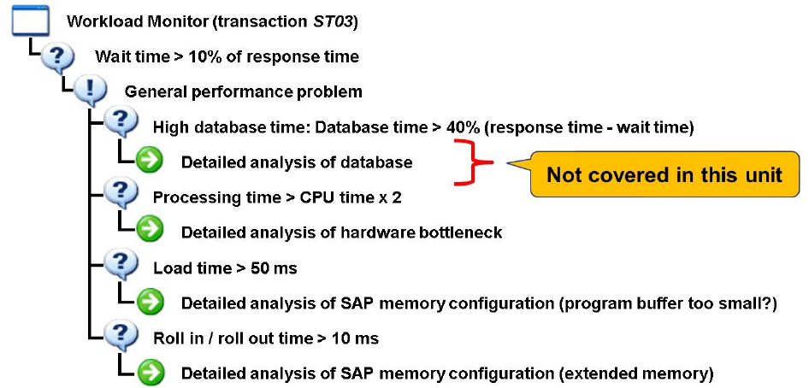
Troubleshooting: Workload Analysis I: General Performance Problems on the ABAP Server

Slide 55
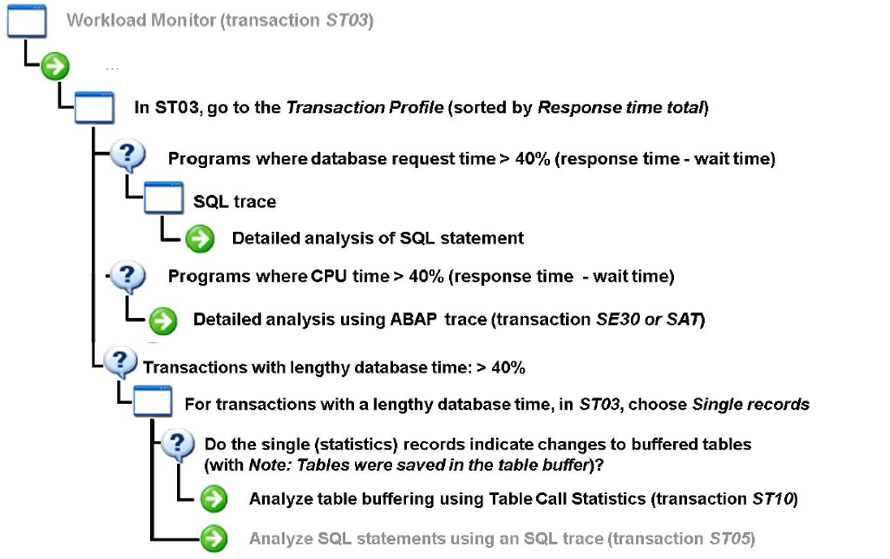
Troubleshooting: Workload Analysis II: General Performance Problems on the ABAP Server

Slide 56
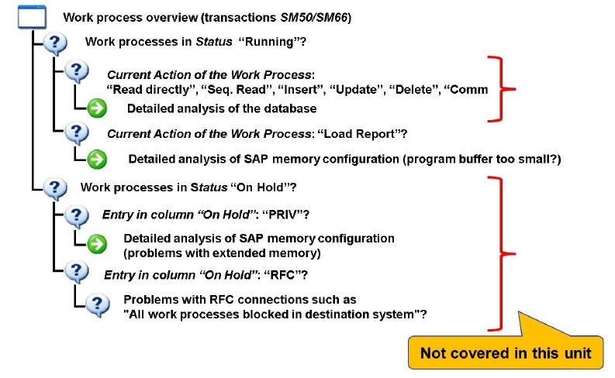
Troubleshooting: Detailed Analysis of SAP Work Processes

Slide 57
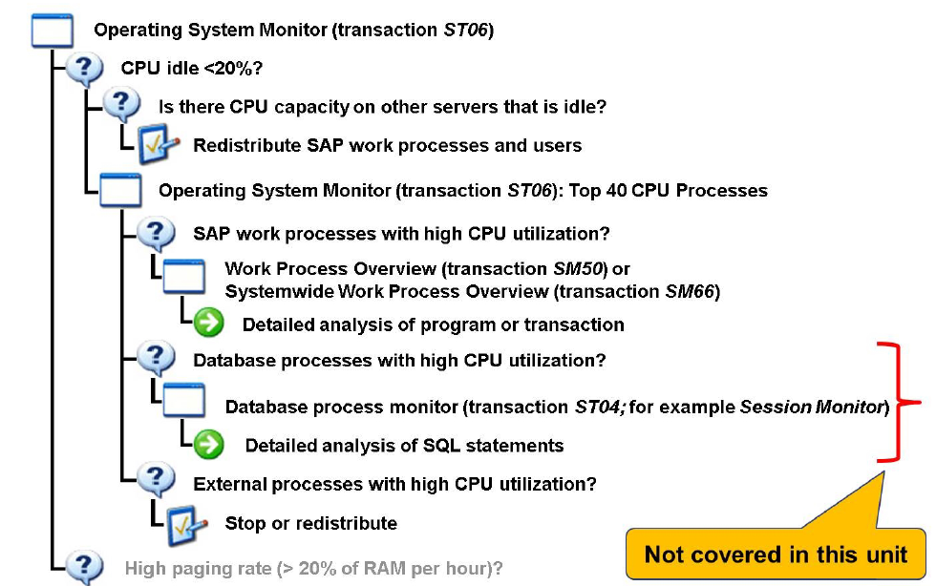
Troubleshooting: Detailed Analysis of a Hardware Bottleneck (CPU)

Slide 58
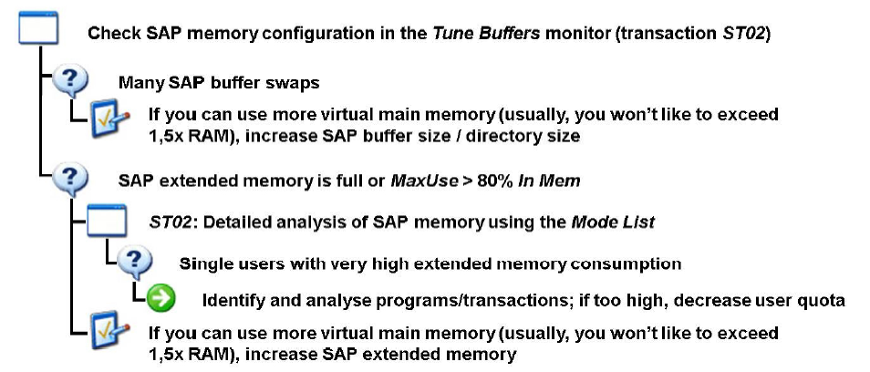
Troubleshooting: Detailed Analysis of a Hardware Bottleneck (Extended Memory)

Slide 59
Agenda
1
SAP Fundamental
2
SAP System Monitoring
3
程式效能分析分類方法

Slide 60
程式效能分析分類方法
程式效能分析分類 | 分析大類 | 分析Tcode | 分析細項 | 分析判斷式
 | MA1 | STAD - Workload分析 | CA01 CA02 CA03 CA04 CA05 CA06 CA07 CA08 CA09 CA10 CA11 CA12 CA13 CA14 CA15 CA16 | □ Dispatcher wait time > 50ms □ Roll-in time > 20ms □ Roll-out time > 20ms □ Roll wait time > 200ms □ GUI time > 200ms □ Load time > 50ms □ Enqueue time > 5ms □ DB Time > 40% □ Processing time > 2 * CPU time □ Time per DB request > 5ms □ DB Avg. Direct reads > 2ms □ DB Avg. Sequential Read > 5ms □ DB Avg. Update time > 5ms □ DB Avg. Delete time > 5ms □ DB Avg. Insert time > 5ms □ Processing Time > 50%
 | MA2 | ST05 - SQL Trace | CA17 | □ Expensive SQL statement
 | MA3 | SAT - 程式效能優化工具 | CA18 CA19 CA20 CA21 CA22 CA23 CA24 CA25 CA26 CA27 | □ Wait □ RFC □ Perform □ DB □ Commit work □ Call □ Dynpro Entry □ Generate □ Import □ System
 | MA4 | DB05 | CA28 | □ Selectivity Analysis

Slide 61
程式效能問題分類方法

Slide 62
程式效能問題分類方法

Slide 63
程式效能問題分析整合
MA01 | STAD - Workload分析
MA02 | ST05 - Trace
MA03 | SAT - 程式效能優化工具
MA04 | DB05
CA01 | Dispatcher wait time > 50ms
CA02 | Roll-in time > 20ms
CA03 | Roll-out time > 20ms
CA04 | Roll wait time > 200ms
CA05 | GUI time > 200ms
CA06 | Load time > 50ms
CA07 | Enqueue time > 5ms
CA08 | DB Time > 40%
CA09 | Processing time > 2 * CPU time
CA10 | Time per DB request > 5ms
CA11 | DB Avg. Direct reads > 2ms
CA12 | DB Avg. Sequential Read > 5ms
CA13 | DB Avg. Update time > 5ms
CA14 | DB Avg. Delete time > 5ms
CA15 | DB Avg. Insert time > 5ms
CA16 | Processing Time > 50%
CA17 | Expensive SQL statement
CA18 | Wait
CA19 | RFC
CA20 | Perform
CA21 | DB
CA22 | Commit work
CA23 | Call
CA24 | Dynpro Entry
CA25 | Generate
CA26 | Import
CA27 | System
CA28 | Selectivity Analysis
MP01 | 資料庫操作
MP02 | Internal Table 操作
MP03 | 程式邏輯處理
MP04 | 與外部系統連接
MC01 | AP Component問題

Slide 64
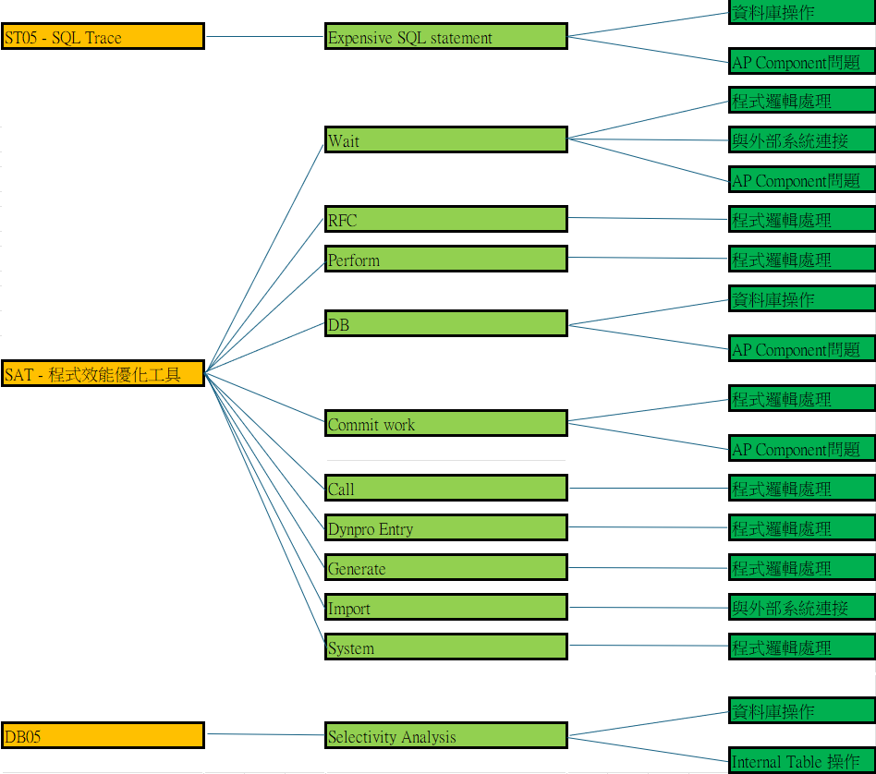
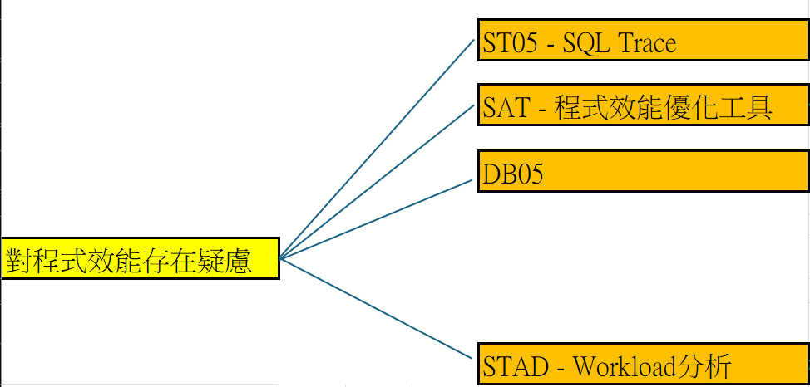

程式效能問題分析整合

Slide 65
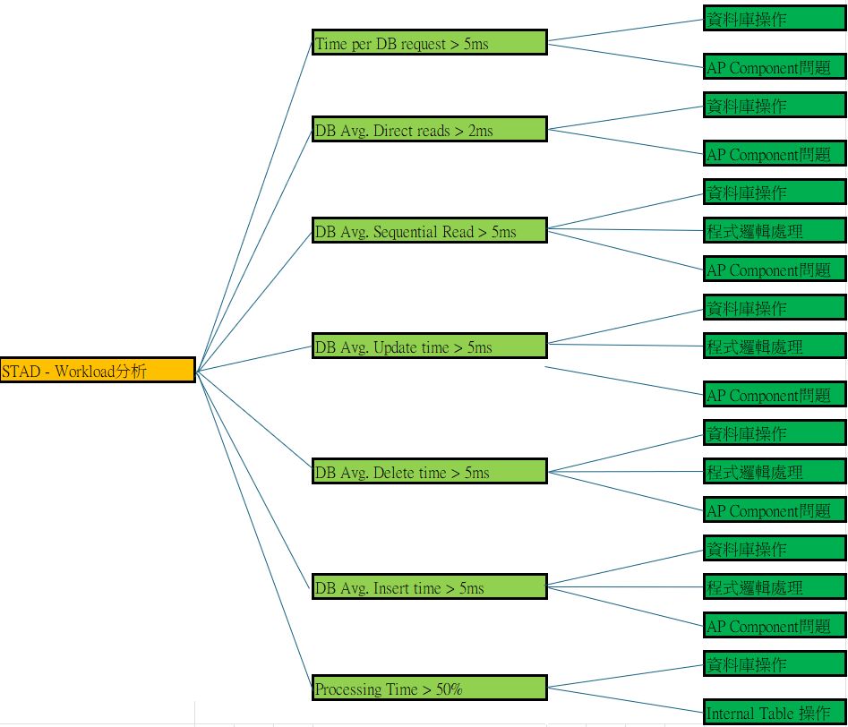
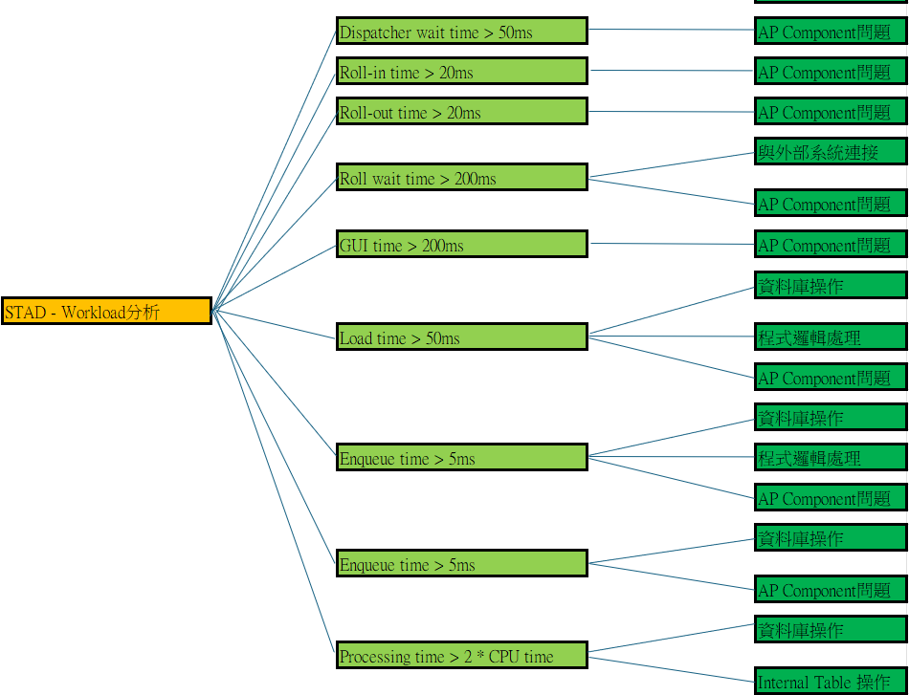
程式效能問題分析整合

Slide 66
Thank You!

Slide 67
Thank You!

